Slide 1
14-795 · FINAL PRESENTATION · APR 2026
VoiceGuard
Voice-Cloning Attack & Detection
Jerry Zeng · Yuxin Liu
A Gradio app that both clones voices and catches them.
Notes:
Hi everyone, we're Jerry and Yuxin. Today we're presenting VoiceGuard — a single application that can both clone a voice and catch it. We built this for 14-795 this semester.

Slide 2
Goals
Goals
What we set out to build
Refined goal after Challenge Analysis
A single tool where anyone can:
Attack — clone a voice from 3–30 s of reference audio
Shield — detect AI-generated speech with verdict + explanation
Why now:
Voice-cloning scams projected at $40 B by 2027
No open tool pairs clone + detect in one interface
Not just "does it work?"
→ "is the detection calibrated and generalizable beyond the benchmark?"
This framing drives every Results slide →
Notes:
Our starting goal was to build one tool where anyone can clone a voice from as little as three seconds of reference audio, and detect whether an audio clip is AI-generated. Voice-cloning scams are projected at $40 billion by 2027, and there's no open-source tool today that pairs cloning and detection in one interface. After our Challenge Analysis, we refined this goal: not just 'does the detector work?', but 'is it calibrated and does it generalize beyond the benchmark?'. That question drives everything in the Results section.

Slide 3
System — Two-Tab Gradio App
System
ATTACK · clone a voice
SHIELD · detect deepfake
OpenVoice v2 (MyShell)
Speaker embedding
MeloTTS base waveform
Tone-color conversion
Inputs:
3–30 s reference audio + free text
Outputs:
Cloned .wav + similarity score (0–100 %)
W2V-AASIST (Tak et al. 2022)
wav2vec 2.0 XLSR (300 M params)
AASIST graph-attention backend
Softmax → spoof_prob
Outputs:
Verdict: REAL / SUSPICIOUS / FAKE
Confidence (0 – 100 %)
8-feature acoustic dashboard
Attention heatmap + spectrogram
→
Send to Shield
Live demo end-to-end in < 30 s
Notes:
VoiceGuard is a two-tab Gradio app. The Attack tab uses OpenVoice v2 from MyShell — it takes a short reference clip, extracts a speaker embedding, generates base speech with MeloTTS, and converts the tone color to match the target speaker. The Shield tab uses W2V-AASIST from Tak et al. — a wav2vec 2.0 XLSR encoder with 300 million parameters plus a graph-attention backend that classifies bonafide versus spoof. A single-click 'Send to Shield' button hands the cloned audio from Attack over to the detector. End-to-end in under 30 seconds — which we'll show live in two slides.

Slide 4
Replicated vs. Added
System
Component | Source | Our change
OpenVoice v2 | MyShell (MIT) | used as-is
W2V-AASIST + best_SSL_model_DF.pth | Tak et al. (MIT) | used pretrained weights
Gradio two-tab app | — | built from scratch
"Send to Shield" workflow | — | built from scratch
AASIST attention heatmap overlay | — | attention × mel spectrogram
8-feature acoustic dashboard | librosa | dashboard + UI integration
Dataset-wide eval pipeline | — | scripts/eval_asvspoof.py (71 k eval)
Feature-distribution calibration | — | scripts/analyze_eval.py
In-the-wild domain-gap test | — | scripts/in_the_wild_test.py
Notes:
To be clear about what's ours and what's not: we used OpenVoice v2 and W2V-AASIST as-is with their pretrained weights — we didn't retrain either model. What we built from scratch is everything in bold here: the two-tab Gradio app, the Send-to-Shield workflow, the attention-heatmap overlay, the 8-feature acoustic dashboard, the dataset-wide evaluation pipeline for all 71,237 utterances, the feature-distribution calibration script, and the in-the-wild domain-gap test.

Slide 5
Live Demo — Attack → Shield
Live Demo
1. Upload
2. Clone
3. Send to Shield
4. Verdict
10-second
reference clip
OpenVoice v2
generates cloned .wav
single-click
hand-off
FAKE
@ 99.97 %
LIVE DEMO · end-to-end < 30 s
Attack: Upload → Clone & Speak → cloned audio + similarity score
Shield: Send to Shield → verdict FAKE @ 99.97 % + attention heatmap highlighting artifact bands
Notes:
Let me show it live. [Click Clone & Speak.] Right now OpenVoice v2 is extracting the speaker embedding from our reference clip and generating speech with MeloTTS. It takes about 15 seconds on CPU. [Wait for the cloned audio to appear; play it.] That sounds like the reference speaker saying our text. Now I click Send to Shield. [Click; switch to Shield tab.] And the verdict: FAKE @ 99.97 % confidence, with the attention heatmap showing which frequency bands the detector focused on.

Slide 6
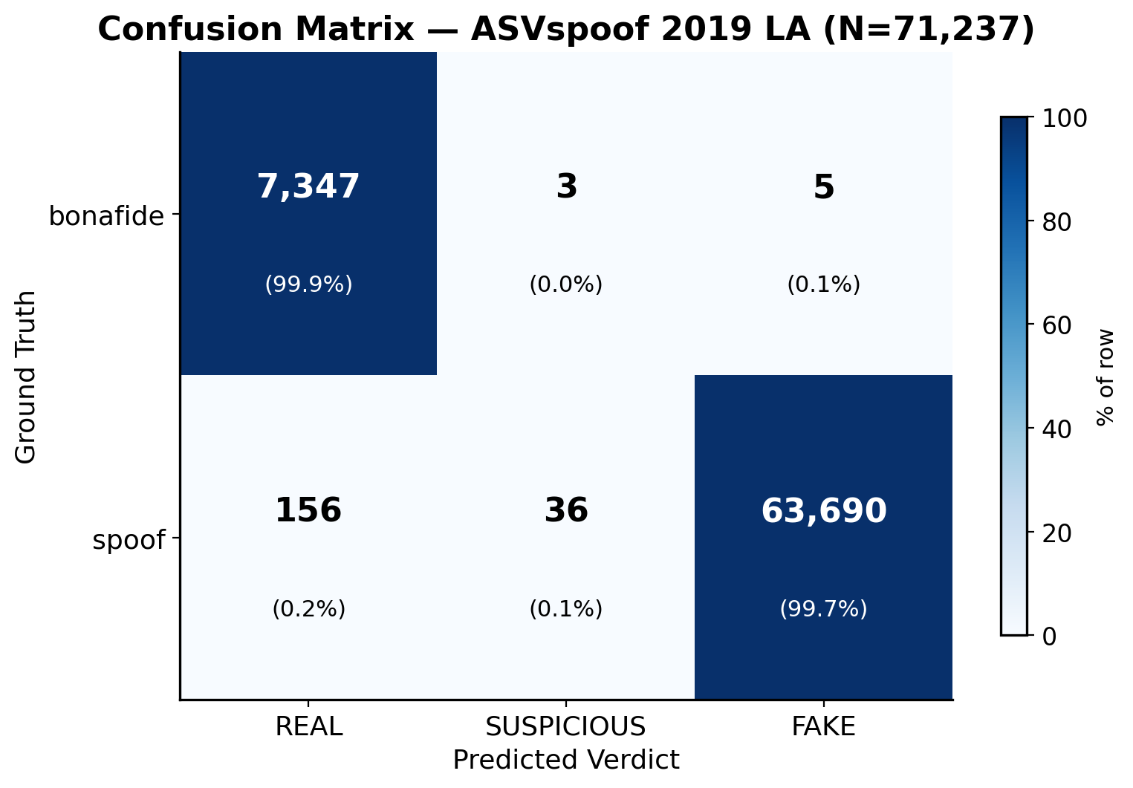
Results — ASVspoof 2019 LA (full eval)
Results
0.146 %
EER (paper reports ~0.7 %)
99.77 %
Overall Accuracy
0.109 %
FPR 8 / 7,355 bonafide
0.244 %
FNR 156 / 63,882 spoof
N = 71,237 · 7,355 bonafide + 63,882 spoof · 8 h 14 min on 4 CPU workers
Notes:
At full scale on ASVspoof 2019 LA — that's 71,237 utterances, 7,355 bonafide plus 63,882 spoofed — here's what the detector does. EER is 0.146 %. Overall accuracy is 99.77 %. The false-positive rate is 0.109 % — just 8 out of 7,355 real speakers mis-flagged as fake. False-negative rate is 0.244 %. These numbers match what the original W2V-AASIST paper reports on this benchmark (around 0.7 % EER). So on studio-quality audio, the detector works exactly as advertised. That's the encouraging half of the story — the surprising half comes in a few slides.

Slide 7
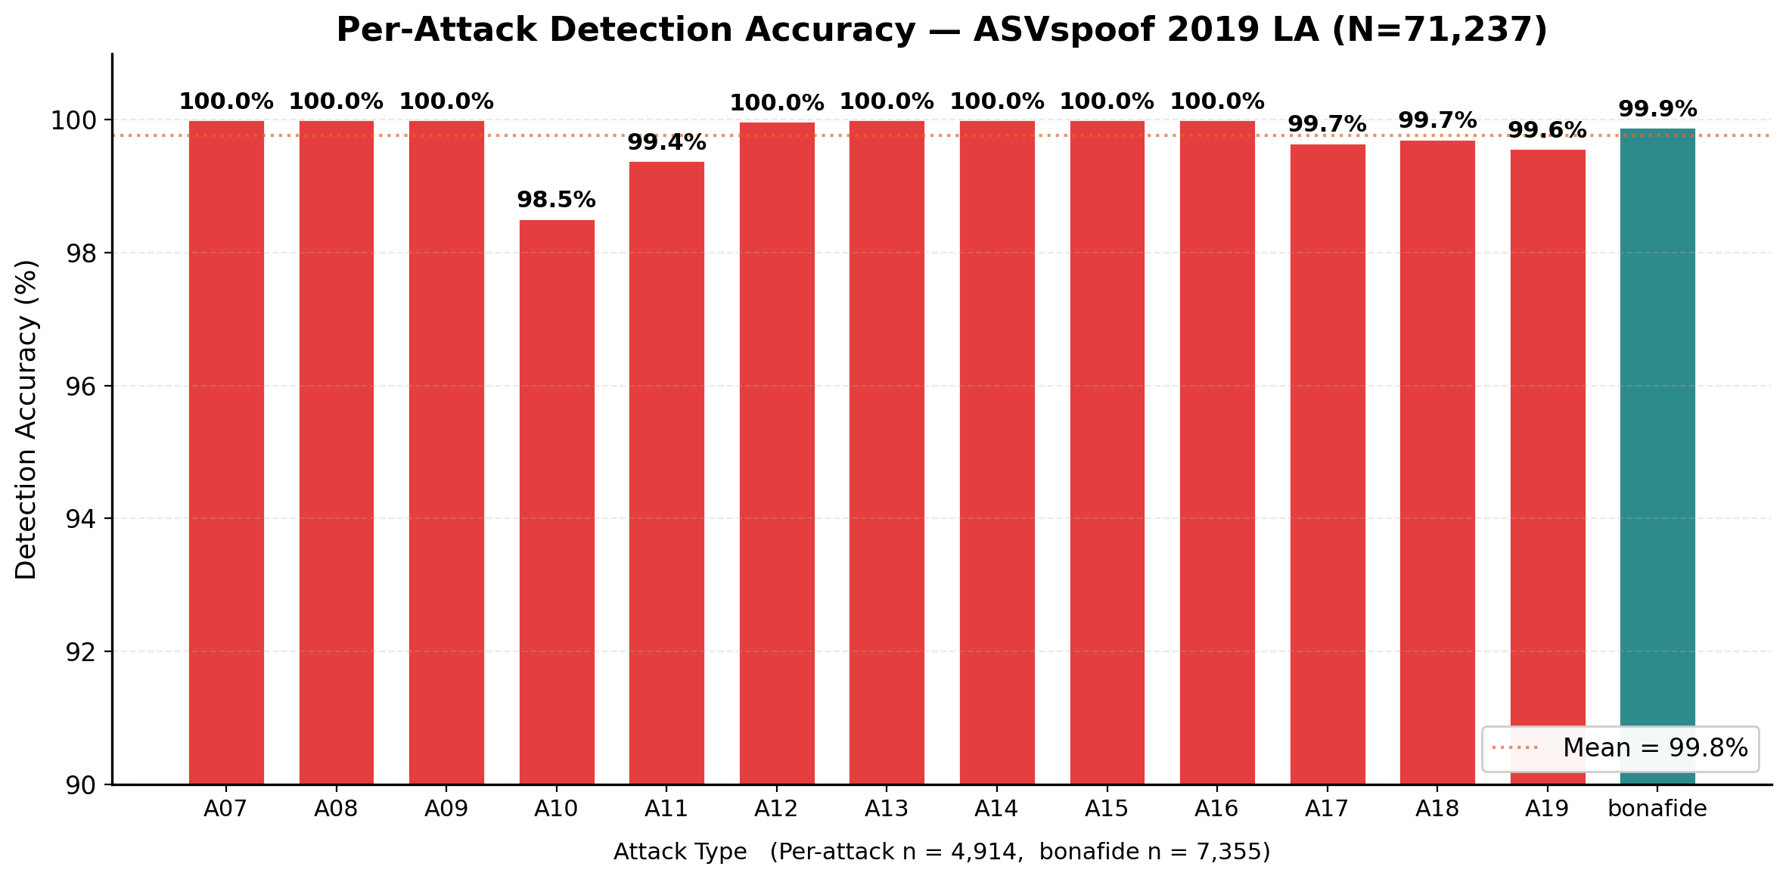
Results — 13 Deepfake Attack Types
Results
Takeaways
7 / 13 attacks detected at 100.0 %
Hardest: A10 (98.5 %) — end-to-end TTS w/ WaveNet vocoder
Runner-up: A11 (99.4 %) WaveRNN, A19 (99.6 %) transfer TTS+VC
Mean detection: 99.8 % — no attack is a systemic blind spot
Each bar ≈ 4,914 utterances
Detection generalizes across TTS, VC, and neural-vocoder synthesis methods at scale.
Notes:
Breaking the results down by attack type. We see all 13 deepfake methods in the eval set — A07 through A19, covering TTS and voice-conversion methods. 7 of them are detected at exactly 100 %. The hardest is A10, an end-to-end TTS with a WaveNet vocoder, at 98.5 %. A11 with WaveRNN and A19 — a transfer-function TTS + VC — come in at 99.4 % and 99.6 %. Mean detection across all thirteen is 99.8 %. Key takeaway: no attack type is a systemic blind spot — the detector generalizes across synthesis methods.

Slide 8
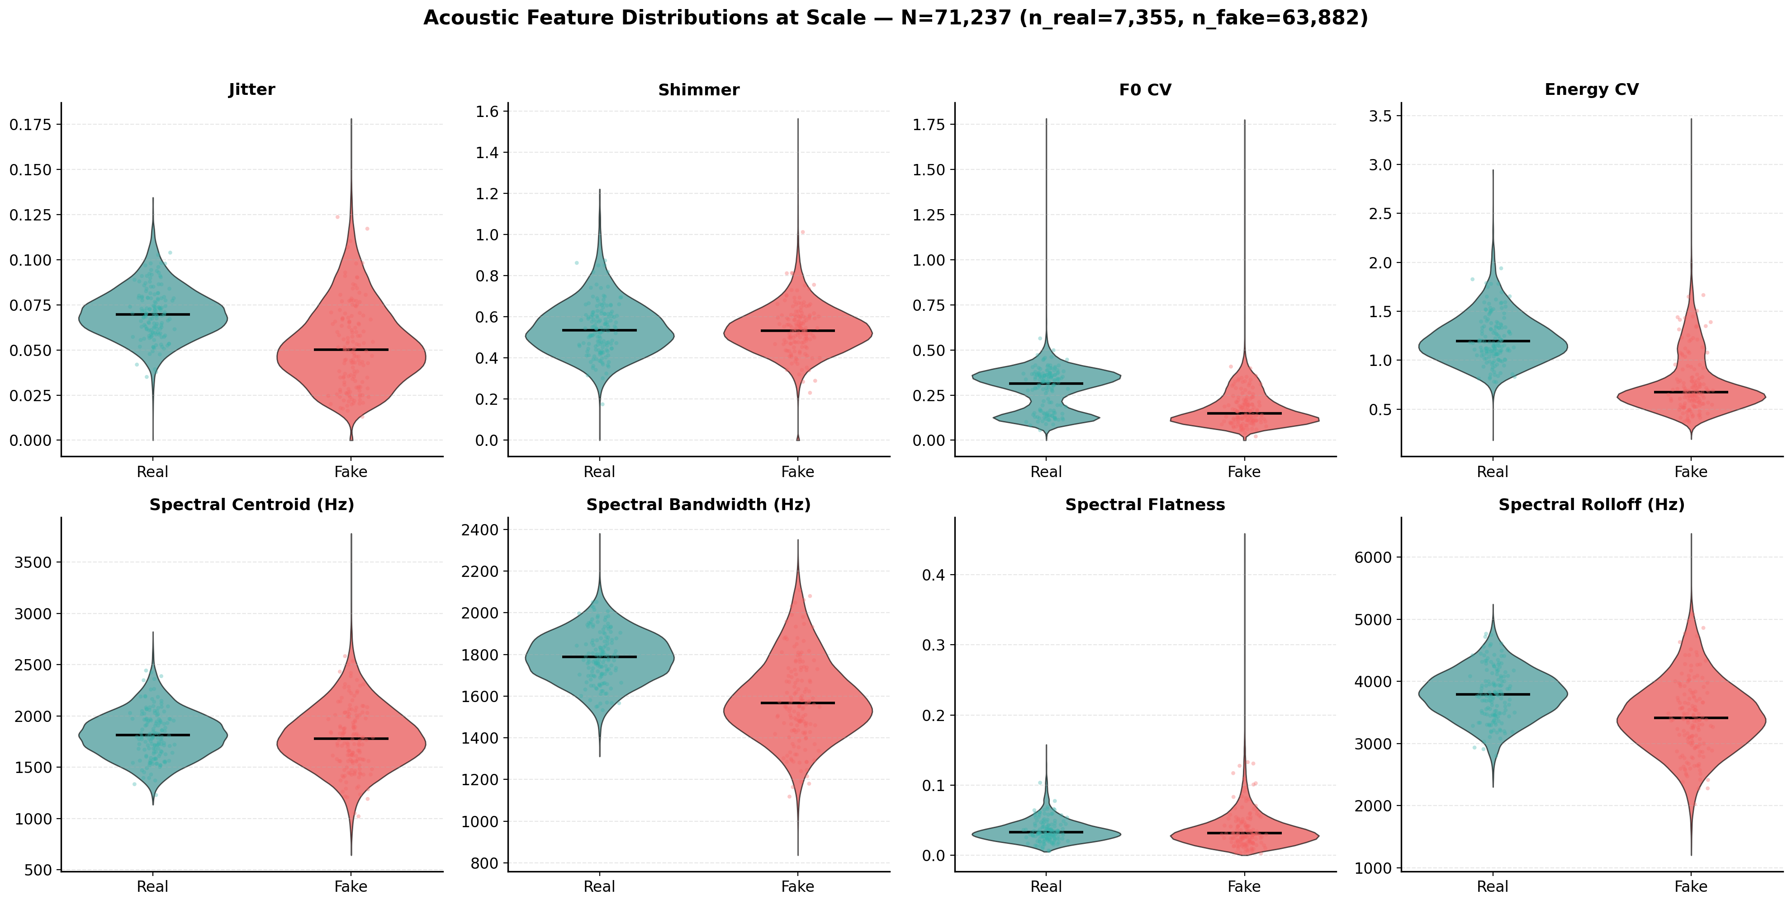
Results — Feature Calibration at Scale
Results
14
samples before
(Challenge Analysis)
71,237
samples now
Nearly 5,000× more
Answers Challenge-Analysis weakness #2
Shimmer, F0 CV, Energy CV separate cleanly — ready for UI percentile context.
Violin plots: black line = median; colored region = kernel density.
Notes:
This slide directly answers a weakness we raised in our Challenge Analysis: 'the acoustic feature values in the Shield tab have no baseline context.' Back then we had only 14 samples. Now we have 71,237. Looking at the violin plots for our 8 acoustic features — Shimmer, F0 CV, Energy CV, and Spectral Centroid all separate cleanly between real and fake at scale. That's enough data to support a percentile-based UI: when the user sees 'Jitter: 0.024', we can tell them that's the 87th percentile of bonafide samples. Weakness #2 from our Challenge Analysis is resolved.

Slide 9
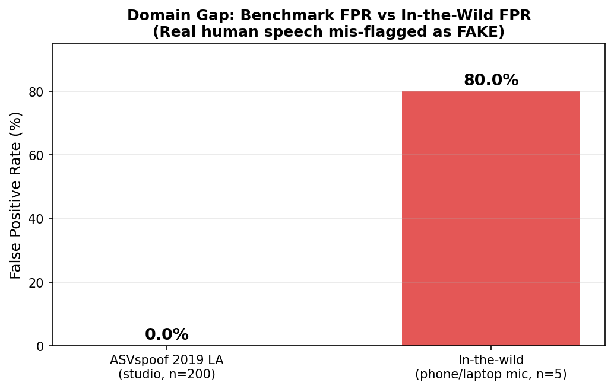
The Gap We Found
Results
0.109 %
FPR on ASVspoof 2019 LA
studio-quality, 7,355 real utterances
80.0 %
FPR on in-the-wild real humans
phone / laptop mic, n = 5
~ 730×
FPR increase from benchmark → wild
On its own benchmark, the model is near-perfect. On everyday audio, 4 / 5 real humans are mis-flagged as AI.
Notes:
Now here's the real finding — the headline of this project. On the benchmark, false-positive rate is 0.109 %. On just 5 recordings of real humans — phone and laptop microphones, people we know speaking naturally — the false-positive rate is 80 %. That's 4 out of 5 real humans mis-flagged as AI-generated. Roughly a 730× degradation, purely from distribution shift. The model is near-perfect on its training distribution, and catastrophic on everyday audio. This gap sets up everything that follows.

Slide 10
Future Work — one step
Future Work
Domain-adaptive fine-tuning on diverse real-world speech
Data — collect ≥ 1,000 hrs real human audio
Resources — think big
Phone codecs (µ-law, Opus, GSM)
Consumer mics (laptop, earbuds, headset)
Noisy conditions (café, car, wind)
50+ demographically diverse speakers
Pool with ASVspoof, fine-tune end-to-end
1 × A100-week GPU for fine-tuning
~ 2 FTE-months for data collection + labelling
$5–10 k microphones + speaker honoraria
Re-evaluate on both benchmark and new in-the-wild set
Notes:
Our one recommended next step: domain-adaptive fine-tuning on diverse real-world speech. Concretely: collect at least 1,000 hours of real human audio, covering phone codecs like µ-law, Opus, GSM, consumer microphones — laptop, earbuds, headset — noisy conditions (cafés, cars, wind), and 50+ demographically diverse speakers. Pool that with ASVspoof and fine-tune W2V-AASIST end-to-end, then re-evaluate. Resources to think big: 1 A100-week of GPU compute, roughly 2 FTE-months for data collection and labelling, and $5–10k for microphone kits and speaker honoraria.

Slide 11
Justification — evidence from our eval
Justification
1
2
Benchmark FPR is already near-zero
In-the-wild FPR is catastrophic
0.109 % (8 / 7,355 real). A bigger / deeper model
won't help when you're already at the floor.
80 % (4 / 5 real humans). A ~730× degradation that
scales with distribution mismatch, not model size.
3
4
The architecture is fine — data isn't
Features already separate real / fake
W2V-AASIST paper: EER ~0.7 % when train ≈ test.
Our reproduction: EER 0.146 % — within range.
At 71 k scale, shimmer / F0-CV / energy-CV
distributions split cleanly → signal exists, domain doesn't.
→ Fine-tuning on diverse real speech is a higher-leverage investment than architectural changes or a bigger model.
Notes:
Four pieces of evidence from our own eval, all pointing to data — not model capacity — as the bottleneck. One: benchmark FPR is already near zero at 0.109 % on 7,355 real samples. Making the model bigger won't drive that lower. Two: in-the-wild FPR is 80 % — a ~730× degradation that scales with distribution mismatch, not model size. Three: the W2V-AASIST paper itself reports sub-1 % EER when training and test distributions match; our reproduction is 0.146 %. The architecture has plenty of capacity. Four: at full 71k scale, our acoustic features already separate real from fake cleanly. The signal exists in the audio — the training set just needs to look like deployment. Fine-tuning on diverse real speech is higher leverage than any architectural change.

Slide 12
Summary
1
Built
an integrated clone + detect tool — attack → shield in < 30 s
2
Benchmarked
at full scale: 99.77 % accuracy, 0.109 % FPR, EER 0.146 % (N = 71,237)
3
Found
80 % FPR on in-the-wild real humans — ~730× benchmark FPR
4
Recommend
collect diverse real-world speech + domain-adapt fine-tune
Notes:
To summarize. One: we built an integrated clone + detect tool with an end-to-end Attack → Shield hand-off in under 30 seconds. Two: we benchmarked at full 71k scale — 99.77 % accuracy, 0.109 % FPR, EER 0.146 %. Three: we found an 80 % FPR on in-the-wild real audio — a ~730× gap — that's the open problem. Four: we recommend collecting diverse real-world speech and domain-adapting the detector. Happy to take questions.

Slide 13
Q&A
Thanks for listening.
Notes:
Thanks — happy to take questions. Things to be ready for: - Why ASVspoof 2019 LA rather than 2021 DF? Pretrained weights are exactly for this benchmark; 13 attack types are clearly labelled; paper-comparable. - Why only 5 in-the-wild samples? Proof of concept; a proper study is the Future-Work dataset we just proposed. - Could you fine-tune in-house? The full 71k eval alone took ~8 hrs on M4 Pro CPU; training needs GPU cluster. - What about the attention heatmap as explanation? Coarse — it shows *where* the model looks but not *why*; see Challenge Analysis for deeper discussion.

